Slide 1
Unlocking the Future of AI Agents with Large Language Models
Review Of Paper “The Rise and Potential of Large Language Model Based Agents: A Survey”
By Aagam Shah

Slide 2
The Evolution and Renaissance of AI Agents
Begin by discussing early philosophical inquiries into the nature of intelligence, citing Denis Diderot’s reflections on whether a parrot’s responses could be considered as signs of understanding.
Introduce Alan Turing's groundbreaking concept from the mid-20th century, which proposed that a machine’s ability to exhibit intelligent behavior equivalent to, or indistinguishable from, that of a human constitutes a form of intelligence.
Describe the trajectory from these early conceptualizations to the development of AI, emphasizing key milestones such as the creation of ELIZA, the first chatbot, and the later development of more complex models like IBM’s Watson.
Highlight how contemporary AI agents have not only mimicked human-like processing but have also begun to surpass human capabilities in specific domains, setting the stage for a deeper exploration into the fabric of modern artificial intelligence.

Slide 3
The Role of LLMs in Modern AI Agents
Large Language Models (LLMs) like GPT-3 and BERT represent a significant evolution in the field of AI. Initially, AI agents were designed for narrow tasks. Now, with the advent of LLMs, we're seeing a shift towards agents that can perform a wide range of complex, human-like functions.
Core Features of LLMs:
Understanding and Generation: LLMs excel in interpreting and generating human-like text. This capability makes them ideal as the 'brains' of AI agents, enabling sophisticated communication and decision-making.
Data Integration: These models process and synthesize vast amounts of information, learning dynamically from their interactions with data.
Autonomy: With advanced decision-making capabilities, LLMs offer a degree of autonomy that pushes the boundaries of what AI agents can achieve.
Impact of LLMs:
LLMs have transformed AI agents from simple tools to complex systems capable of understanding nuances and making informed decisions.
They serve as a foundation for building more intelligent, responsive, and adaptable AI systems across various sectors, including healthcare, finance, and customer service.

Slide 4
A Framework for Next-Generation AI Agents
This framework is crucial as it integrates cognitive processes with sensory inputs to enable decision-making and actions in the real world.
Components of the Framework:
Brain: The 'brain' of an AI agent, powered by an LLM, handles complex decision-making. It synthesizes information from various sources, learns from data interactions, and makes informed decisions based on this analysis.
Perception: This component involves using advanced sensors and data inputs to perceive the environment. AI agents gather and interpret multimodal data (text, visuals, audio) to understand their surroundings comprehensively.
Action: The action component translates the brain's decisions into real-world actions. This can range from digital responses, like generating text or scheduling tasks, to physical actions, such as maneuvering a robot or operating devices.
Operation Flow:
Perception: Data is collected from the environment.
Brain: Data is processed and decisions are formulated.
Action: Decisions are executed, influencing the environment.

Slide 5
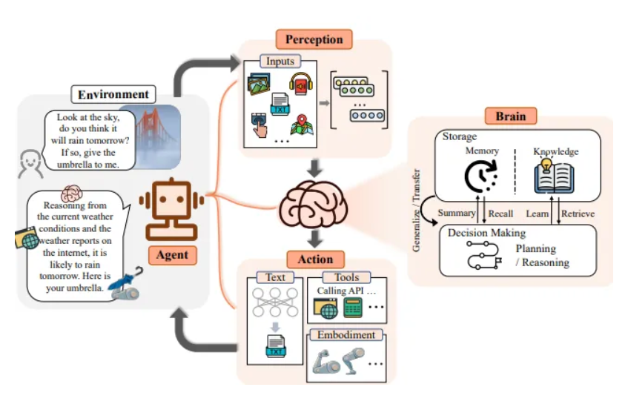

Slide 6
Exploring the 'Brain' of AI Agents
This section focuses on the internal workings of the AI agent's 'brain,' where cognitive capabilities and sensory perceptions converge to form a sophisticated system capable of advanced functions.
Cognitive Capabilities:
Memory and Knowledge Retention: AI agents store and recall past experiences and information, akin to human memory. This feature enables them to make informed decisions based on historical data.
Reasoning and Decision-Making: AI agents simulate human-like reasoning by evaluating different scenarios and determining the most effective course of action based on logical processing.
Learning and Adapting: Central to advanced AI systems is their ability to learn from new data and adapt their behavior accordingly. This dynamic adjustment is crucial for evolving strategies in response to environmental changes.
Sensory Perceptions:
Textual Data: AI agents analyze textual information to comprehend and respond to written commands, requiring advanced capabilities in language parsing and context understanding.
Visual Data: Through cameras and other imaging devices, AI agents 'see' their surroundings, enabling them to identify objects and understand spatial relationships.
Audio Data: AI agents process audio inputs to 'hear' and respond to sounds, which is vital for interactions involving spoken language.
Operation Example:
Perception: An AI agent receives a customer query via text and analyzes background noise from an audio input.
Brain: It assesses the query's intent, retrieves relevant information, and formulates a response.
Action: The agent responds to the customer with a helpful answer and appropriate tone, adjusted based on the detected background noise.

Slide 7
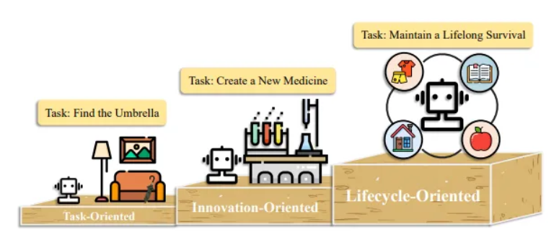
AI Agents in Action: Real-World Applications
we explore the diverse and impactful applications of AI agents enhanced by LLMs across various industries. These applications not only showcase the agents' capabilities but also illustrate their potential to revolutionize traditional practices.
Single-Agent Applications:
Task-Oriented Deployment: AI agents in customer service automate responses and handle inquiries, enhancing efficiency and customer satisfaction. These agents utilize natural language understanding to deliver precise and timely responses.
Innovation-Oriented Deployment: In sectors like pharmaceuticals, AI agents accelerate research and development. They predict drug compound effectiveness, significantly speeding up trials and improving research precision.

Slide 8
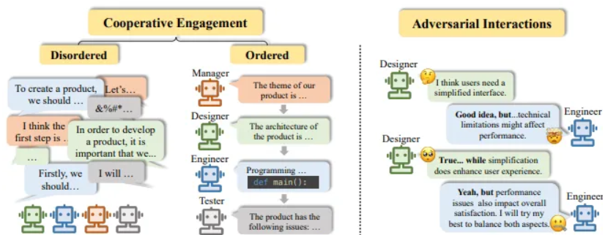
AI Agents in Action: Real-World Applications
Multi-Agent Scenarios:
Cooperative Interaction: In manufacturing, multiple AI agents collaborate to optimize production lines. They coordinate tasks, share responsibilities, and adapt to changes in real-time, boosting efficiency and product quality.
Competitive Interaction: AI agents employed in strategic games refine their decision-making skills by competing against each other, fostering continuous improvement in their strategies.

Slide 9

AI Agents in Action: Real-World Applications
Human-Agent Interaction:
Instructor-Executor Model: In education, AI agents customize learning experiences by adapting content and teaching strategies to individual student needs, enhancing educational outcomes.
Equal Partnership Model: In creative industries, AI agents collaborate with humans to produce innovative artworks and music compositions, combining computational analysis with human creativity.

Slide 10
Agent Society: Behavior, Social Dynamics, and Ethical Considerations
Behavior and Personality of AI Agents:
Social Behavior: AI agents are programmed to adhere to social norms and etiquette, enhancing their ability to integrate into human societies effectively. For example, customer support bots tailor their communication style to be more effective and contextually appropriate based on the interaction.
Personality Traits: Depending on their designated roles, AI agents can exhibit tailored personality traits. For instance, an AI developed for team management might display leadership qualities such as decisiveness and the ability to motivate others.
Environment for Agent Society:
Text-based Virtual Environments: These are ideal for operations involving massive datasets or complex simulations, as they are not constrained by physical realities.
Physical Environments: AI agents in physical settings must adapt to dynamic conditions, such as robots in manufacturing facilities or autonomous vehicles navigating city streets.
Ethical and Social Risks:
Privacy and Surveillance: The increasing personal data processed by AI agents necessitates robust mechanisms to safeguard privacy and maintain trust.
Dependency and Autonomy: There is a risk that society may become overly dependent on AI, potentially impacting norms around work and interpersonal relationships. It’s essential to maintain a balance where AI complements human capabilities without dominating them.
Bias and Fairness: Ensuring AI systems operate without perpetuating existing biases is critical. AI agents must be trained on diverse datasets to minimize bias and promote fairness.

Slide 11

Agent Society: Behavior, Social Dynamics, and Ethical Considerations

Slide 12
Future Directions and Transformative Impact of LLM-Based AI Agents
Advancements and Achievements:
AI agents have demonstrated substantial technical prowess, performing complex tasks, adapting to new environments, and intricately interacting with both humans and other agents. These advancements not only enhance existing applications but also pave new paths in sectors like healthcare, education, and customer service.
Societal Impact:
The integration of AI agents into various domains promises increased productivity and innovation. Beyond industrial applications, AI has the potential to address large-scale global challenges, such as climate change and health crises, by leveraging vast amounts of data and providing new insights.
Future Directions:
The AI research community is encouraged to continue innovating and to develop ethical guidelines that ensure AI operations are safe, fair, and transparent. Emphasis is placed on collaborative efforts among computer scientists, ethicists, policymakers, and the public to align AI development with human values and societal needs.
Challenges and Open Problems:
Developing holistic performance metrics that capture an agent's adaptability, ethical behavior, and long-term learning capabilities.
Establishing effective benchmarks that test AI agents across diverse scenarios, enhancing security measures against adversarial attacks, and ensuring scalability in complex environments.

Slide 13
Thanks!
Does anyone have any questions?
aagamshah0812@gmail.com

